Slide 1
Wireless Networks and Protocols
WiFi Header and Management
1

Slide 2
Outline
802 protocol overview
Wireless LANs – 802.11
» Overview of 802.11
» 802.11 MAC, frame format, operations
» 802.11 management
» 802.11*
» Deployment example
Personal Area Networks – 802.15
2

Slide 3
801.11 MAC Frame Format
Upper layer data
2048 byte max
256 upper layer header
NAV information Or
Short Id for PS-Poll
FC
Duration Address
/ID 1
2 6
Address 2
Address Sequence Address
3 Control 4
DATA
FCS
2
6 6 2 6
0-2312 4
bytes
Protocol Version
Frame Type and Sub Type
To DS and From DS
More Fragments
Retry
Power Management
More Data
WEP
Order
IEEE 48 bit address
Individual/Group
Universal/Local
46 bit address
MSDU
Sequence Number
Fragment Number
CCIT CRC-32 Polynomial
BSSID –BSS Identifier
TA - Transmitter
RA - Receiver
SA - Source
DA - Destination
Source and destination address: “final” source/dest for the packet Receiver and transmitter address:
nodes wireless nodes that tr/rec packet
3

Slide 4

Detailed 802.11 MAC Frame Format
MAC header
6 6
bytes 2
2
6
2
6
0-2312
4
Frame | Duration/ | Address | Address | Address | Seq. | Address
control | ID | 1 | 2 | 3 | control | 4
FCS
Frame body
Protocol version
2
Type
Sub-type
To From More DS DS Frag
1 1 1
Retry
Pwr More
Mgmt Data
1 1
WEP Order
1 1
bits
2
4
1
4

Slide 5
Packet Types
Type/sub-type field is used to indicate the type of the frame
Management:
» Association/Authentication/Beacon
Control
» RTS, CTS, CF-end, ACK
Data
» Data only, or Data + CF-ACK, or Data + CF-Poll or Data + CF-Poll + CF-ACK
5

Slide 6
Why Four Addresses?
Station to AP: end-end source and destination address, and the address of the AP
AP to AP: end-to-end source and destination address; receiving and transmitting address
AP to station: end-end source and destination address, and the address of the AP
Access Point (AP)
ethernet 128.238.36
R
Internet
128.238.36.1
Access Point (AP) 128.238.36.3
128.238.36.2
MAC A
MAC B
MAC C
MAC
B
Server
6

Slide 7
Addressing Fields
To DS | From DS | Message | Address 1 | Address 2 | Address 3 | Address 4
0 | 0 | station-to-station frames in an IBSS (ad hoc); all mgmt/control frames | DA | SA | BSSID | N/A
0 | 1 | From AP to station | DA | BSSID | SA | N/A
1 | 0 | From station to AP | BSSID | SA | DA | N/A
1 | 1 | From one AP to another in same DS | RA | TA | DA | SA
Devices involved in this transmission
RA: Receiver Address TA: Transmitter Address DA: Destination Address SA: Source Address BSSID: MAC address AP
in an infrastructure BSS
Wired LAN
AP
AP
MAC A
MAC B
7
Peter A. Steenkiste

Slide 8
Some More Fields
Duration/ID: SIFS+ACK in DCF mode/ID is used in PCF mode (discussed later)
More Frag: 802.11 supports fragmentation of data
More Data: In polling mode, station indicates it has more data to send when replying to CF- POLL (PCF)
RETRY is 1 if frame is a retransmission; WEP (Wired Equivalent Privacy)
Power Mgmt is 1 if in Power Save Mode; Order = 1 for strictly ordered service
8

Slide 9
802.11b PLCP: Short Preamble
PLCP: Physical Layer Convergence Procedure
Short Preamble = 72 bits
Preamble and PLCP header transmitted at 1 and 2 Mbps
Longer preamble: interoperable with older WiFi versions
Different formats for later (OFDM) standards
Transmitted at
1 Mbps
Transmitted at
2 Mbps
Transmitted at
X Mbps
56 bit Preamble | 16 bit Start Frame Delimiter | Signal Speed 1,2,5.5, 11 Mbps | Service (unused) | Length of Payload | 16 bit CRC | Payload 34-2346 bytes

Slide 10
Multi-bit Rate
802.11 allows for multiple bit rates
» Allows for adaptation to channel conditions
» Specific rates dependent on the version
Algorithm for selecting the rate is not defined by the standard – left to vendors
» Still a research topic!
» More later in the semester
Packets have multi-rate format
» Different parts of the packet are sent at different rates
» Why?

Slide 11
Data Flow Examples
Case 1: Packet from a station under one AP to another in same AP’s coverage area
Case 2: Packet between stations in an IBSS
Case 3: Packet from an 802.11 station to a wired server on the Internet
Case 4: Packet from an Internet server to an
802.11 station

Slide 12
Some Background: Forwarding Logic
When node needs to send an IP packet:
» In the same IP network?
Check destination IP address
» Yes: forward based on MAC address
Uses ARP protocol to map IP to MAC address
» No: forward packet to “gateway” router
Uses MAC address of the router
Application
Presentation
Session
Transport
Network
Data link
Physical
Access Point (AP)
ethernet 128.238.36
R
Internet
128.238.36.1
Access Point (AP) 128.238.36.3
128.238.36.2
MAC A
MAC B
MAC C
MAC
B
Server

Slide 13
Communication in LANs
Every interface to the network has a IEEE MAC and an IP address associated with it
» True for both end-points and routers
IP address inside a LAN share a prefix
» Prefix = first part of the IP address, e.g., 128.238.36
» Can be used to determine whether devices are on same LAN
Traffic outside LAN needs to go through router
Access Point (AP)
ethernet 128.238.36
R
Internet
128.238.36.1
Access Point (AP) 128.238.36.3
128.238.36.2
MAC A
MAC B
MAC C
MAC
B
Server
14

Slide 14

Case 1: Communication Inside BSS
Access Point (AP)
ethernet
128.238.36
R
Internet
To DS:1
Access Point (AP)
MAC A
From DS:1
MAC C
MAC B
Server
128.238.36.1
128.238.36.3
128.238.36.2
AP knows which stations are registered with it so it knows when it can send frame directly to the destination
Frame can be set directly to the destination by AP

Slide 15

Case 2: Ad Hoc
MAC A
MAC B
To DS:0
From DS:0
Direct transmit only in IBSS (Independent BSS), i.e., without AP
Note: in infrastructure mode (i.e., when AP is present), even if B can hear A, A sends the frame to the AP, and AP relays it to B

Slide 16
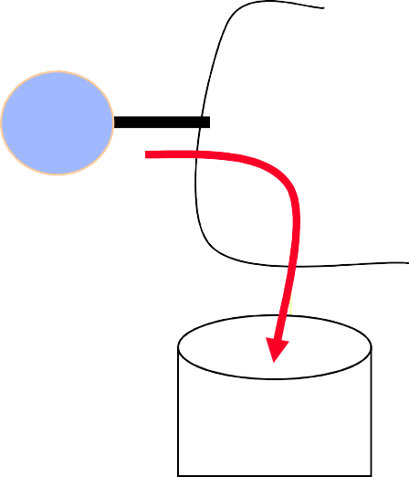
Case 3: To the Internet
Access Point (AP)
ethernet
128.238.36
R
Internet
To DS:1
Access Point (AP)
MAC B
MAC A
MAC C
Server
128.238.36.2
128.238.36.1
128.238.36.3
MAC A determines IP address of the server (using DNS)
From the IP address, it determines that server is in a different subnet
Hence it sets MAC R as DA;
» Address 1: BSSID, Address 2: MAC A; Address 3: DA
AP will look at the DA address and send it on the ethernet
» AP is an 802.11 to ethernet bridge
Router R will relay it to server

Slide 17
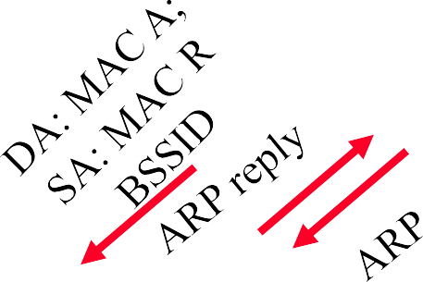
Case 4: From Internet to Station
ARP
ARP reply
Dest: 128.238.36.1
128.238.36
Access Point (AP) I
ethernet
R
Internet
DMAC: A; SMAC: R
MAC R
Access Point (AP) II
MAC
MAC
MAC
B 128.238.36.2
C
^{A} 128.238.36.1
128.238.36.2
Server
Packet arrives at router R – uses ARP to resolve destination IP address
» AP knows nothing about IP addresses, so it will simply broadcast ARP on its wireless link
» DA = all ones – broadcast address on the ARP
MAC A host replies with its MAC address (ARP reply)
» AP passes on reply to router
Router sends data packet, which the AP simply forwards because it knows that MAC A is registered
Will AP II broadcast the ARP request on the wireless medium? How about the data packet?

Slide 18
Summary
Wifi packets have 4 MAC addresses
Needed to support communication inside a LAN, across access points connected by a wired LAN
WiFi frames have a multi-rate format, i.e., different parts are sent at different rates
» The header is sent at a lower rate to improve chances it can be decoded by receivers
» Contains critical information such as virtual carrier sense, and the bit rate used for the data

Slide 19
Outline
Brief history
802 protocol overview
Wireless LANs – 802.11 – overview
802.11 MAC, frame format, operations
802.11 management
802.11 security
802.11 power control
802.11*
802.11 QoS

Slide 20
Management and Control Services
Association management
Handoff
Security: authentication and privacy
Power management
QoS

Slide 21




802.11: Infrastructure Reminder
802.11 LAN
Station (STA)
802.x LAN
» terminal with access mechanisms to the wireless medium and radio contact to the access point
STA₁
Portal
Access Point
BSS
1
Access Point
» station integrated into the wireless LAN and the distribution system
Basic Service Set (BSS)
» group of stations using the same AP
Distribution System
Access
Portal
» bridge to other (wired) networks
ESS
Point
BSS₂
Distribution System
» interconnection network to form one logical network (ESS: Extended Service Set) based
on several BSS
STA₂
802.11 LAN
STA₃

Slide 22
Service Set Identifier - SSID
Mechanism used to segment wireless networks
» Multiple independent wireless networks can coexist in the same location
» Effectively the name of the wireless network
Each AP is programmed with a SSID that corresponds to its network
Client computer presents correct SSID to access AP
Security Compromises
» AP can be configured to “broadcast” its SSID
» Broadcasting can be disabled to improve security
» SSID may be shared among users of the wireless segment

Slide 23
Association Management
Stations must associate with an AP before they can use the wireless network
» AP must know about them so it can forward packets
» Often also must authenticate
Association is initiated by the wireless host – involves multiple steps:
Scanning: finding out what access points are available
Selection: deciding what AP (or ESS) to use
Association: protocol to “sign up” with AP – involves exchange of parameters
Authentication: needed to gain access to secure APs – manyoptions possible
Disassociation: station or AP can terminate association

Slide 24
Association Management: Scanning
Stations can detect AP using scanning
Passive Scanning: station simply listens for Beacon and gets info of the BSS
» Beacons are sent roughly 10 times per second
» Power is saved
Active Scanning: station transmits Probe Request; elicits Probe Response from AP
» Saves time + is more thorough
» Wait for 10-20 msec for response
Scanning all available channels can become very time consuming!
» Especially with passive scanning
» Cannot transmit and receive frames during most of that time – not a big problem during initial association
25
Peter A. Steenkiste

Slide 25
Association Management: Selecting an AP and Joining
Selecting a BSS or ESS typically must involve the user
» What networks do you trust? Are you willing to pay?
» Can be done automatically based on stated user preferences (e.g., the “automatic” list in Windows)
The wireless host selects the AP it will use in an ESS based on vendor-specific algorithm
» Uses the information from the scan
» Typically simply joins the AP with the strongest signal
Associating with an AP
» Synchronization in Timestamp Field and frequency
» Adopt PHY parameters
» Other parameters: BSSID, WEP, Beacon Period, etc.

Slide 26
Association Management: Roaming
Reassociation: association is transferred from active AP to a new target AP
» Supports mobility in the same ESS – layer 2 roaming
Reassociation is initiated by wireless host based on vendor specific algorithms
» Implemented using an Association Request Frame that is sent to the new AP
» New AP accepts or rejects the request using an Association Response Frame
Coordination between APs is defined in 802.11f
» Allows forwarding of frames in multi-vendor networks
» Inter-AP authentication and discovery typically coordinated using a RADIUS server
» “Fast roaming” support (802.11r) also streamlines authentication and QoS, e.g. for VoIP

Slide 27
Association Management: Reassociation Algorithms
Failure driven: only try to reassociate after connection to current AP is lost
» Typically efficient for stationary clients since it not common that the best AP changes during a session
» Mostly useful for nomadic clients
» Can be very disruptive for mobile devices
Proactive reassociation: periodically try to find an AP with a stronger signal
» Tricky part: cannot communicate while scanning other channels
» Trick: user power save mode to “hold” messages
» Throughput during scanning is still affected though
– Mostly affects latency sensitive applications

Slide 28
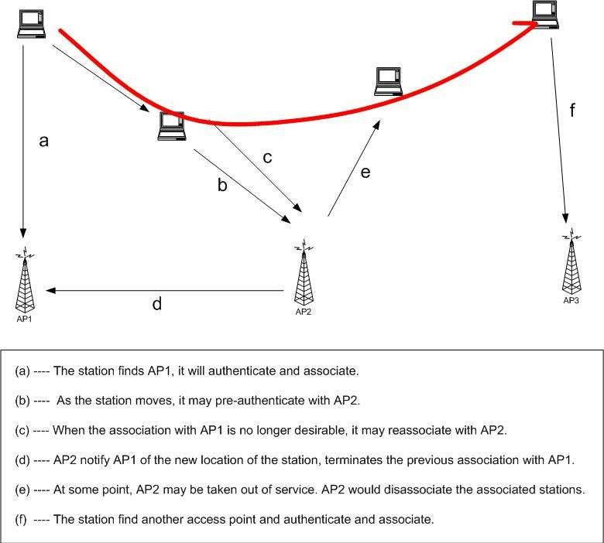
Ex.

Slide 29
Outline
Brief history
802 protocol overview
Wireless LANs – 802.11 – overview
802.11 MAC, frame format, operations
802.11 management
802.11 security
802.11 power control
802.11*
802.11 QoS

Slide 30
WLAN Security Requirements
Authentication: only allow authorized stations to associate with and use the AP
Confidentiality: hide the contents of traffic from unauthorized parties
Integrity: make sure traffic contents is not modified while in transit

Slide 31
WLAN Security Exploits
Insertion attacks: unauthorized Clients or AP
» Client: reuse MAC or IP address –free service on “secured” APs
» AP: impersonate an AP, e.g., use well known name
Interception and unauthorized monitoring
» Packet Analysis by “sniffing” – listening to all traffic
Brute Force Attacks Against AP Passwords
» Dictionary Attacks Against SSID
Encryption Attacks
» Exploit known weaknesses of WEP
Misconfigurations, e.g., use default password
Jamming – denial of service
» Cordless phones, baby monitors, leaky microwave oven, etc.

Slide 32
Security in 802.11
802.1x: port-based authentication for LANs
» Port-based authentication for LANs
WEP: Wired Equivalent Privacy
» Achieve privacy similar to that on LAN through encryption
» Intended to provide both privacy and integrity
» RC4 and CRC32
» Has known vulnerabilities
WPA: Wi-Fi Protected Access
» Larger, dynamically changed keys
802.11i (WPA2)
» Builds on WPA but fixes various vulnerability
» Uses AES for encryption (TKIP version is deprecated)
– Pre-shared keys (PSK) versus Enterprise options

Slide 33
MAC Filtering
Each client is identified by its 802.11 Mac Address
Each AP can be programmed with the set of MAC addresses it accepts (“white list”)
Combine this filtering with the AP’s SSID
Very simple solution
» Some overhead to maintain list of MAC addresses
But it is possible to forge MAC addresses …
» Unauthorized client can “borrow” the MAC address of an authenticated client
» Built in firewall will discard unexpected packets

Slide 34
Wired Equivalent Privacy WEP
Original standard for WiFi security
Very weak standard: key could be cracked with a couple of hours of computing (much faster today)
» Too much information is transmitted in the clear
» No protocol for encryption key distribution
» Clever optimizations can reduce time to minutes
All data then becomes vulnerable to interception
» WEP typically uses a single shared key for all stations
The CRC32 check is also vulnerable so that the data could be altered as well
» Can makes changes without even decrypting!
Not recommended

Slide 35
Wi-Fi Protected Access WPA
Introduced by Wi-Fi Alliance as an interim solution after WEP flaws were published
» Uses a different Message Integrity Check
» Encryption still based on RC4, but uses 176 bit key (48bit IV) and keys are changed periodically
» Also frame counter in MIC to prevent replay attacks.
Can be used with 802.1x authentication (optional)
» It generates a long WPA key that is randomly generated, uniquely assigned and frequently changed.
» Attacks are still possible since people sometimes use short, poorly random WPA keys that can be cracked
802.11i is a “permanent” security fix
» Builds on the interim WPA standard (i.e. WPA2)
» Replaces RC4 by the more secure Advanced Encryption Standard (AES) block encryption
» Better key management and data integrity
» Uses 802.1x for authentication.
Peter A. Steenkiste
36

Slide 36
















Authentication in WLAN Hotspots
Upon association with the AP, only authentication traffic can pass through, as defined by IEEE 802.1x
not authenticated
authenticated
Authentication traffic only
The protocol used to transport authentication traffic is the Extensible Authentication Protocol (EAP - RFC3748)
37

Slide 37
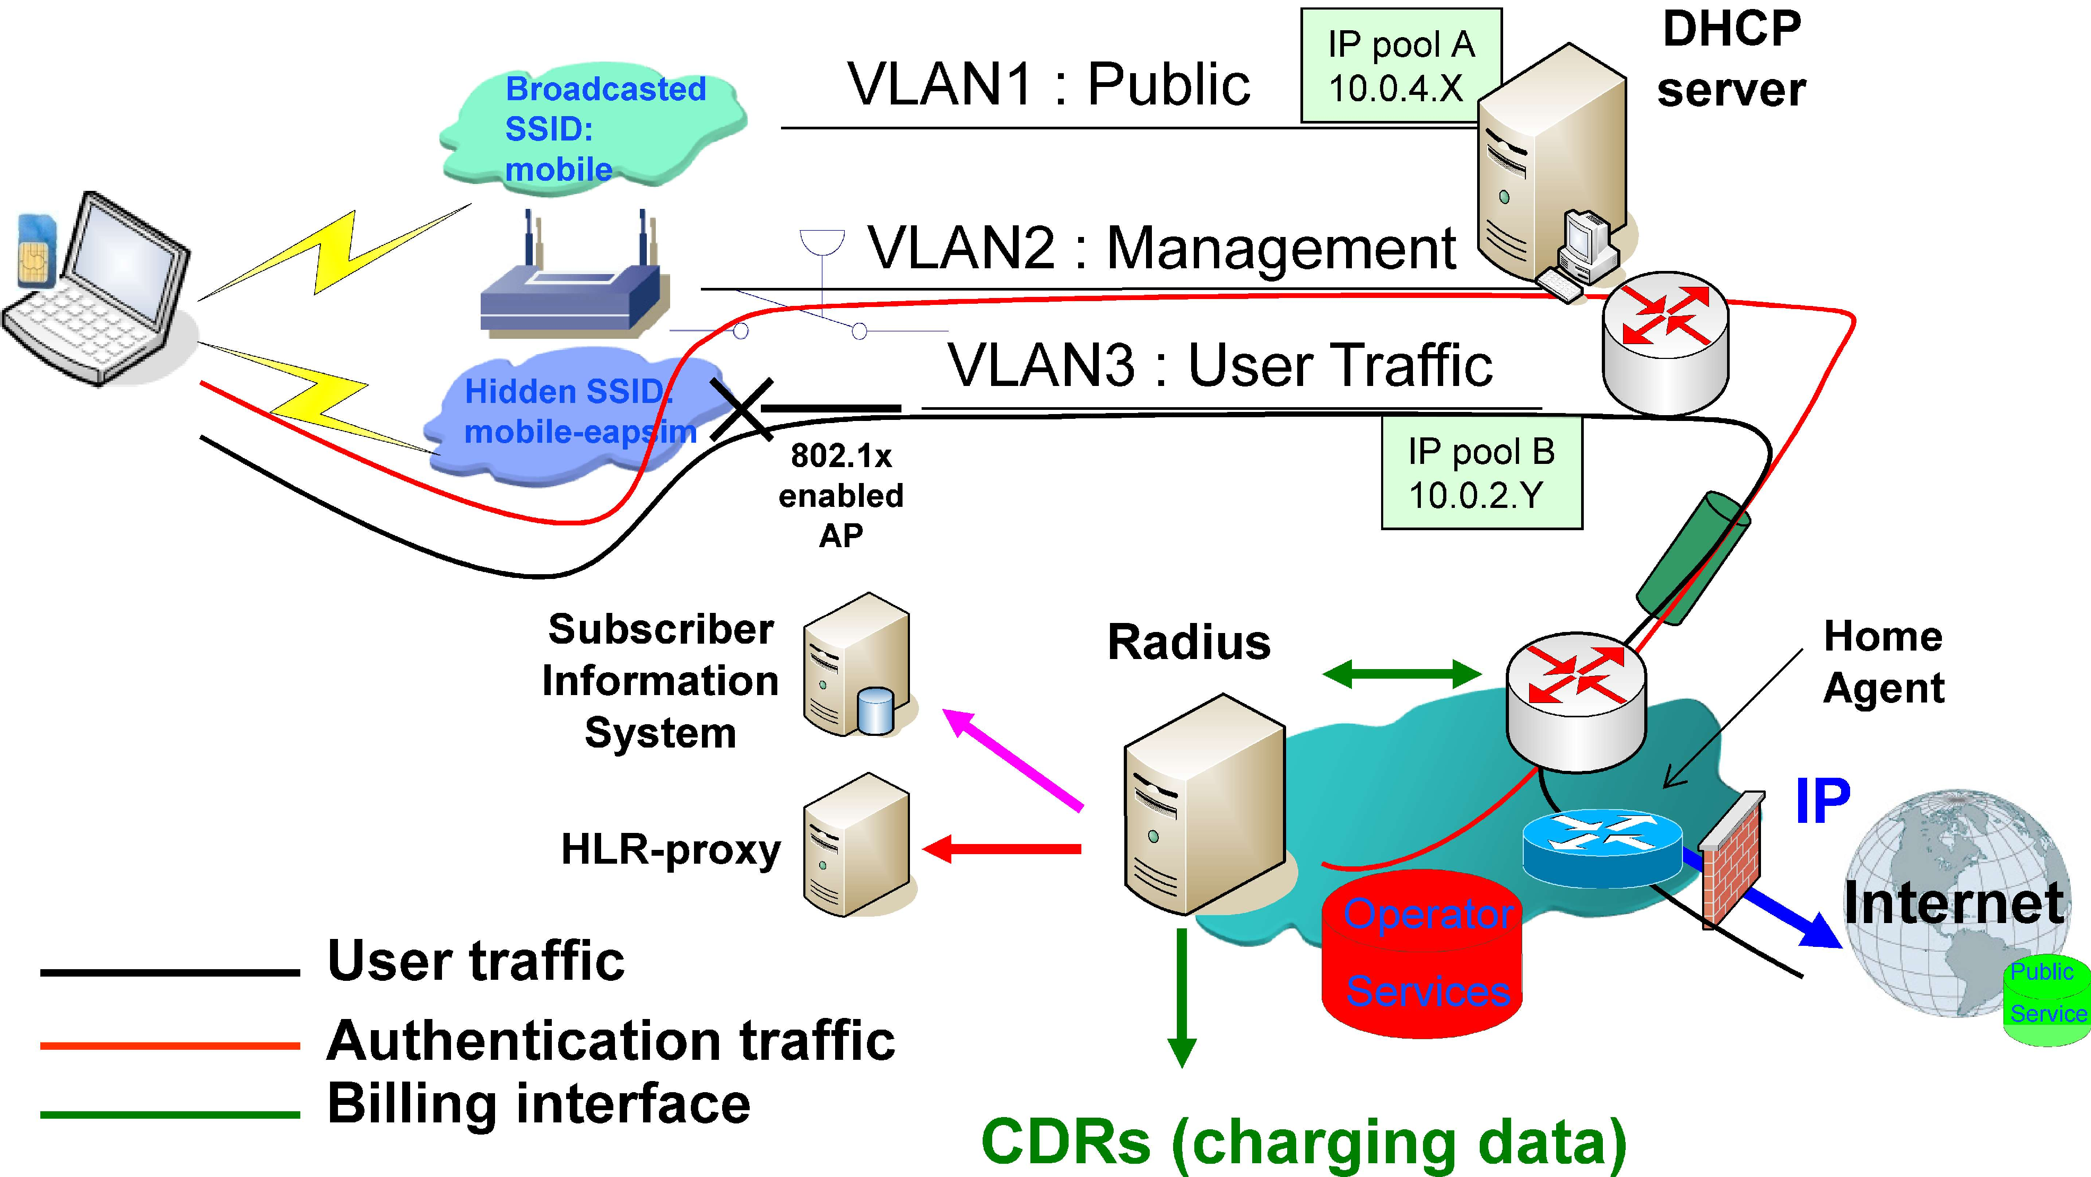
Dual SSID Approach
IP pool A 10.0.4.X
DHCP
server
Broadcasted SSID:
mobile
VLAN1 : Public
VLAN2 : Management
VLAN3 : User Traffic
IP pool B 10.0.2.Y
Hidden SSID: mobile-eapsim
802.1x
enabled AP
Subscriber Information System
Radius
Home Agent
IP
Internet
Public Service
HLR-proxy
Operator Services
User traffic
Authentication traffic Billing interface
CDRs (charging data)
38

